Slide 1
CS4770 Lecture 5 – Symmetric Encryption
By Chad Mourning

Slide 2
What is encryption, anyway?
Encryption is the science of keeping secrets.
Given a plaintext piece of information.
Perform some operation to produce a ciphertext.
This is encryption.
Hope that the receiver knows the operations to reverse this process.
This is decryption.
Hope that any other party does not know these operations.
This is sub-optimal.

Slide 3
Okay, so what’s symmetric encryption?
Has been used since at least the ancient Romans.
Wouldn’t surprise me if they used it elsewhere in the world
If we have any double majors in history, maybe you could research the history of encryption in the non-Western world.
Relies on a reversible process using a single shared key.
This is opposed to asymmetric encryption, which we’ll discuss later.

Slide 4
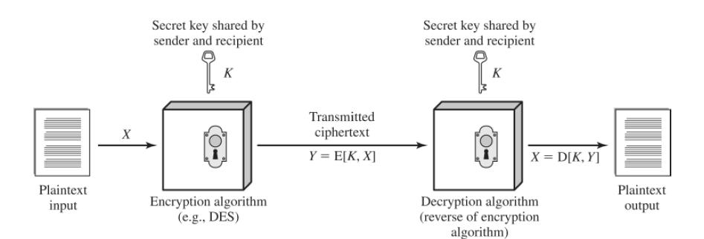
An illustration.

Slide 5
Example 1: Rot13
Live Demos!
tr 'A-Za-z' 'N-ZA-Mn-za-m' <<< "The Quick Brown Fox Jumps Over The Lazy Dog“
PicoCTF, if it’s not under maintenance.

Slide 6
Example 2: Caesar Cipher
Live Demo!
https://mybinder.org/v2/gh/ADMETE-OHIO/HEAD

Slide 7
Example 3: One-Time Pad (XOR)
Live Demo!
https://mybinder.org/v2/gh/ADMETE-OHIO/jupyter-publice/HEAD
Maybe I’ll give you an assignment to break a OTP with a reasonable key.
We’ll see if we make it to frequency analysis, so you don’t have to inspect results by hand.

Slide 8
Attacks against Symmetric Encryption
Cryptanalysis
If you know how the algorithm works, maybe there are shortcuts.
If you know something about the plaintext, maybe there are shortcuts.
https://www.youtube.com/watch?v=G2_Q9FoD-oQ
https://www.youtube.com/watch?v=V4V2bpZlqx8
Required Viewing: An Exam Question will come from these videos. You can wait until closer to the exam to watch them, so you don’t have to watch them twice. I may or may not remember to remind you.
About 22 minutes total.
The Gold Bug, by Edgar Allan Poe
~32 pages. Not required reading… yet.
Brute Force
Would take a very long time for large keys.
Quantum Brute Force?

Slide 9
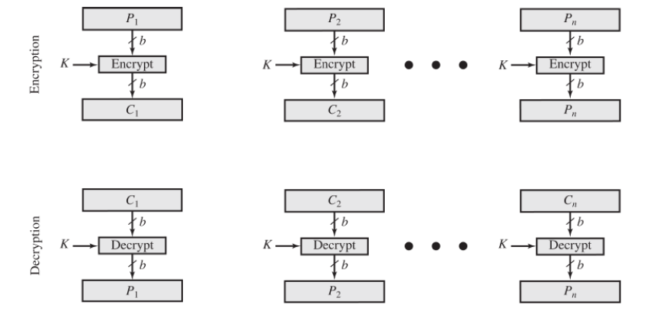
Symmetric Block Encryption
The OTP example we did used a separate bit in the XOR for each bit in the text.
Block encryption breaks the plaintext bits into chunks and applies the same technique on each chunk.
This is different from stream ciphers.
Samples are always a danger to cryptography, so if you know the correct value of 1 “block”, it makes it easier to guess the key.

Slide 10
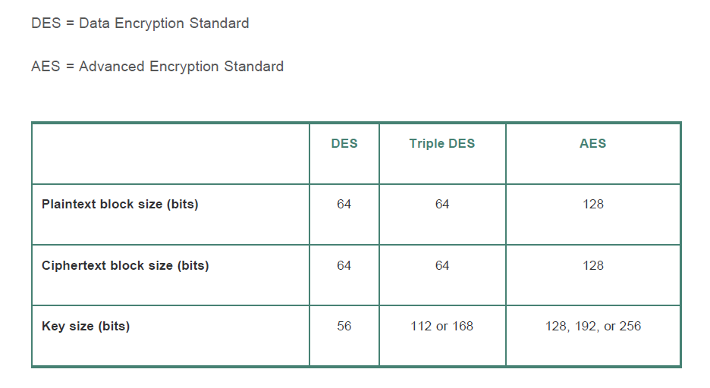
An Overview of DES and AES parameters.

Slide 11
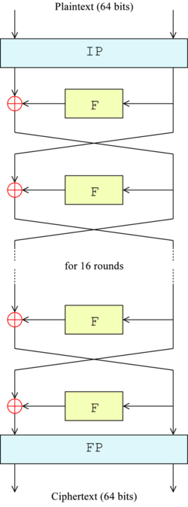
DES – Data Encryption Standard
Introduced by NIST in 1977 (FIPS 46)
Implementation Details can be found here:
https://en.wikipedia.org/wiki/Data_Encryption_Standard
As seen on the last slide, it uses a 56 bit key
This was small even when it was introduced.
In 1977, Diffie and Hellman said that with $20MM in hardware you could crack it in a day.
In 1993, Michael Wienar said $1M in hardware could crack it in 7 hours.
In 1997, RSA Security sponsored a contest awarded $10,000 to the first person to crack a DES encrypted messages.
Matt Curtain, one of the team members that broke it spoke at OU circa 2009ish; good talk. I will recount some details now for those in attendance.
There is a “simplified DES” with a 10-bit key that I may assign as an assignment. Stay tuned.

Slide 12
Bonus Bounty(s?)
I can’t guarantee I will do more of these this semester, but there’s a least one.
I have encrypted a file using DES and posted it on Blackboard. First person to e-mail me the decrypted contents, which are in plain English, get a 1% bonus on their final grade.
No questions asked. Be careful with those AWS bills.
This will not effect anyone else’s grade, so don’t call it P2W.

Slide 13
Practical: Encrypting Files Using OpenSSL
Openssl help
Openssl enc help
openssl enc -des -in plaintext -out ciphertext
Openssl enc –d –des –in ciphertext –out plaintext

Slide 14
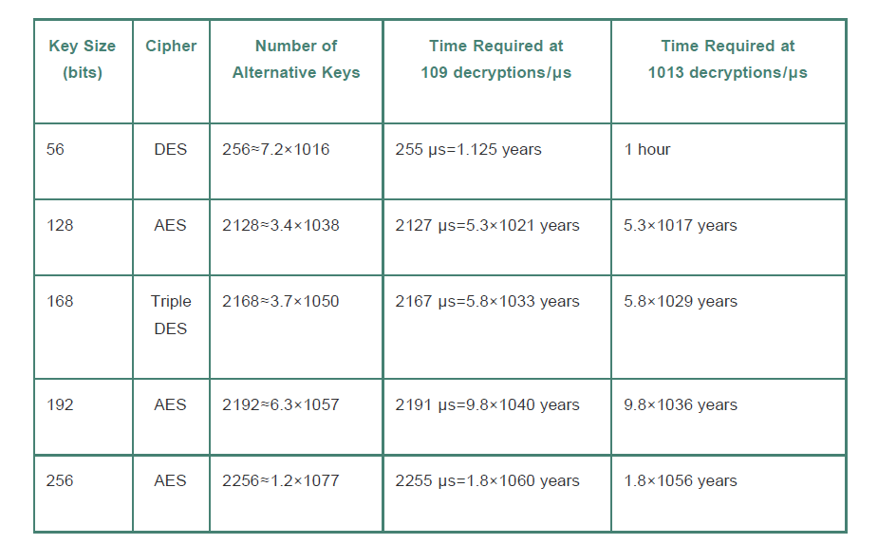
Brute Force Revisited

Slide 15
Triple DES
Exactly what it sounds like
Do DES 3 times, in sequence, with three different keys.
You want attacks to be slow, but you want encryption/decryption to be fast
Necessarily Sequential Operations
Yes, I think XOR is associative and commutative, but there are some other permutational steps which have to happen in sequence.
People have had 45 years to cryptanalytically break DES and haven’t, but, if they did, doing it 3 times probably wouldn’t help.

Slide 16
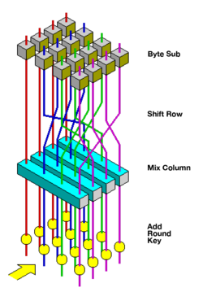
AES – Advanced Encryption Standard
2001 NIST FIPS 197
In 1997 NIST announced a contest to pick a new encryption standard.
15 algorithms made it through Round 1
5 algorithms advanced to Round 2
Implementation details are given in Chapter 20 of the book, and also here:
https://en.wikipedia.org/wiki/Advanced_Encryption_Standard
Also known as Rijndael

Slide 17
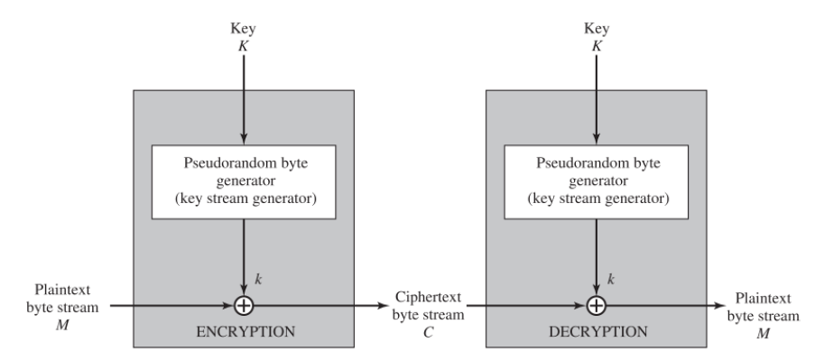
Stream Ciphers
Change the content of the bytestream (plaintext).
Not clear to me why this avoids the sampling problem if you are still applying the same algorithm.
Should be trivial to implement a stream cipher using C++ rand(), where our shared symmetric key is the srand() value.
I bet I can do this live.

